Slide 1
Big Data Stream Mining
By Saurabh Gupta

Slide 2
Agenda
Introduction
Sources
Normal Streams – Classification, Regression and Clustering
Distributed Streams – Classification, Regression and Clustering
Q&A

Slide 3
Introduction
Stream mining is online analytics, deals with what is happening now
Stream mining includes all we need to do with data mining: Classification, Regression, Clustering with algorithms and techniques specially designed for mining the streams
Maintain models online
• Incorporate data on the fly
• Unbounded training sets
• Detect changes and adapts
• Dynamic models

Slide 4
Introduction
Big Data Streams:
Volume + Velocity (+ Variety)
Too large for single commodity server main memory
Too fast for single commodity server CPU
A solution needs to be distributed and scalable
There are two types of data streams : Normal Stream and Distributed Stream
There are a number of technologies in the market for stream mining : which includes but not limited to Samza, S4, Storm, Spark, Flink (still in its early stages)

Slide 5
Data Sources
User clicks
Search queries
News
Emails
Tumblr posts
Flickr photos
Finance stocks
Credit card transactions
Wikipedia edit logs
Facebook statuses
Twitter updates

Slide 6
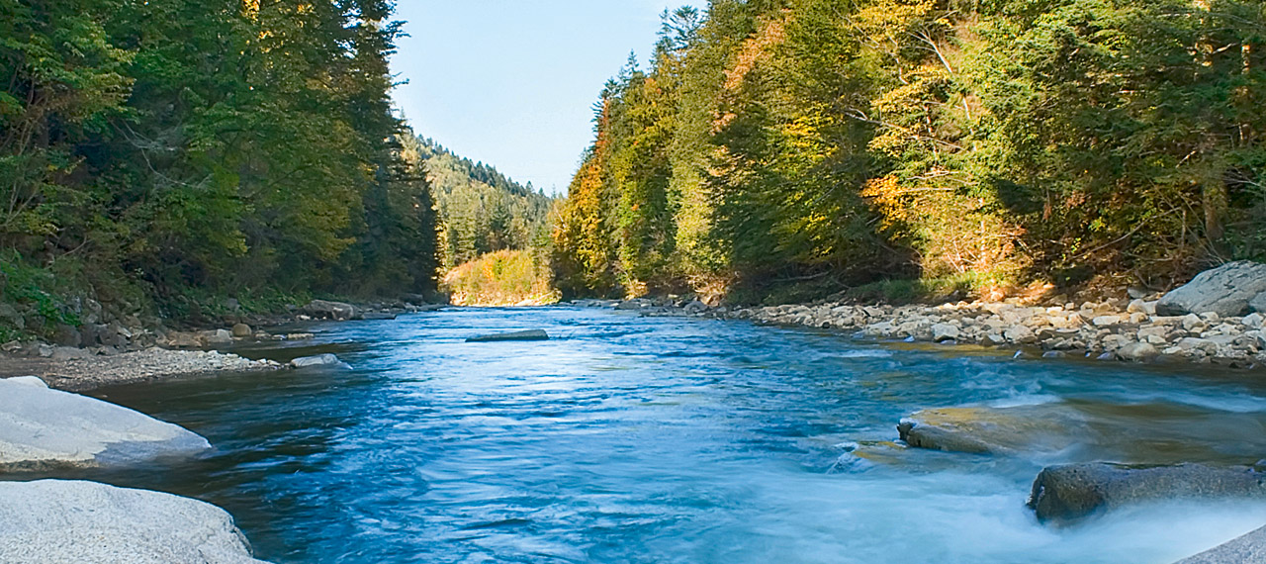
Normal Stream

Slide 7
Classification
Given a set of training examples belonging to nC different classes, a classifier
algorithm builds a model that predicts for every unlabeled instance x the
class C to which it belongs, e.g., email spam filter
Routine Algorithms: Naïve Bayes, Perceptron Learning

Slide 8
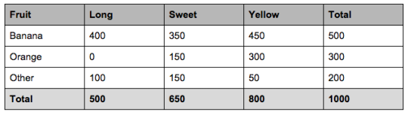
Naïve Bayes
50% of the fruits are bananas, 30% are oranges and 20% are other fruits
From 500 bananas 400 (0.8) are Long, 350 (0.7) are Sweet and 450 (0.9) are Yellow
Out of 300 oranges 0 are Long, 150 (0.5) are Sweet and 300 (1) are Yellow
From the remaining 200 fruits, 100 (0.5) are Long, 150 (0.75) are Sweet and 50 (0.25) are Yellow
For a fruit long, sweet and yellow
Banana:P(Banana|Long,Sweet,Yellow)=P(Long|Banana).P(Sweet|Banana).P(Yellow|Banana).P(Banana).P(Long).
P(Sweet) = 0.252
Orange = 0
Other Fruit: P(Other|Long,Sweet,Yellow)=P(Long|Other).P(Sweet|Other).P(Yellow|Other).P(Other).P(Long).P(Sweet).
P(Yellow) = 0.01875

Slide 9
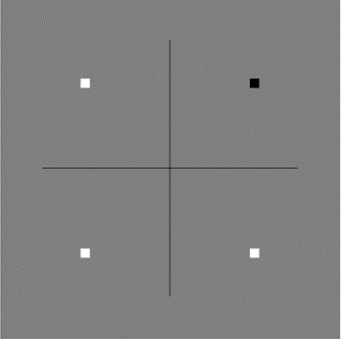
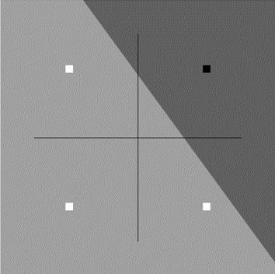
Perceptron Learning
Example: AND
Here is a representation of the AND function White means false, black means true for the output -1 means false, +1 means true for the input
-1 AND -1 = false
-1 AND +1 = false
+1 AND -1 = false
+1 AND +1 = true

Slide 10
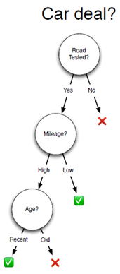
Decision Tree

Slide 11
Streams – Needs Different Methods
Traditional Classification techniques scan the training data multiple times – Off line process
Not possible in data streams
Example: Decision trees – at each node best possible split is determined by considering all the data, for all attributes
Concept drift occurs in streams
Changes in the classification model over time
Stream Classification techniques
Hoeffding tree Algorithm
Very Fast Decision Tree (VFDT)
Concept-adapting Very Fast Decision Tree

Slide 12
Hoeffding Tree Algorithm
Decision Tree Learning Algorithm
Used originally to track Web click streams and predict next access
Hoeffding trees – small sample is adequate to choose optimal splitting attribute
Determines smallest number of samples needed at a node to split

Slide 13

Hoeffding Tree Algorithm
Packets > 10
Data Stream
yes
no
Protocol = http
Packets > 10
yes
no
Bytes > 60K
Protocol = http
yes
New data can be integrated as it streams in
Protocol = ftp

Slide 14
Hoeffding Tree Algorithm
Strengths
Scales better than traditional methods
Sub-linear with sampling
Very small memory utilization
Incremental
Make class predictions in parallel
New examples are added as they come
Weakness
Could spend a lot of time with ties
Memory used with tree expansion
Cannot handle concept drift

Slide 15
Very Fast Decision Tree
A small sample can often be enough to choose a near optimal decision
Collect sufficient statistics from a small set of examples
Estimate the merit of each alternative attribute
Choose the sample size that allows to differentiate between the alternatives
Modifications to Hoeffding Tree
Near-ties broken more aggressively
Deactivates certain leaves to save memory
Poor attributes dropped

Slide 16
Very Fast Decision Tree
Compare to Hoeffding Tree: Better time and memory
Compare to traditional decision tree
Similar accuracy
Better runtime
Still does not handle concept drift

Slide 17
Concept-adapting VFDT
Concept Drift :
Given an input sequence ⟨x1,x2,…,xt⟩, output at instantt an alarm signal if there is a
distribution change, and a prediction x̂ t+1 minimizing the error |x̂ t+1 − xt+1|
Time-changing data streams
Incorporate new and eliminate old
Sliding window – sensitive to window size (w)

Slide 18
Concept-adapting VFDT
CVFDT
Increments count with new example
Decrement old example
Sliding window – but does not construct model from scratch
Nodes assigned monotonically increasing IDs
Grows alternate subtrees
When alternate more accurate => replace old
Better runtime than VFDT
Model consistent with sliding window on stream
Keep sufficient statistics also at internal nodes

Slide 19
VFDTc: Adapting to Change
Monitor error rate
When drift is detected
Start learning alternative subtree in parallel
When accuracy of alternative is better
Swap subtree
No need for window of instances

Slide 20
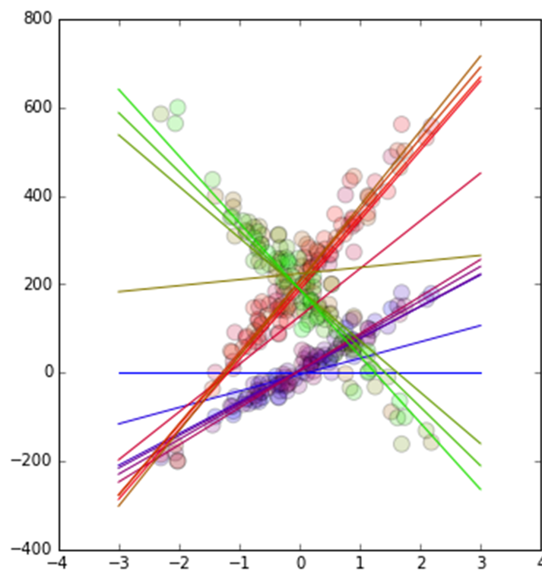
Regression
Given a set of training examples with a numeric label, a regression algorithm
builds a model that predicts for every unlabeled instance x the value with
high accuracy
Do it using Perceptron and using the concept of Stochastic Gradient Descent

Slide 21
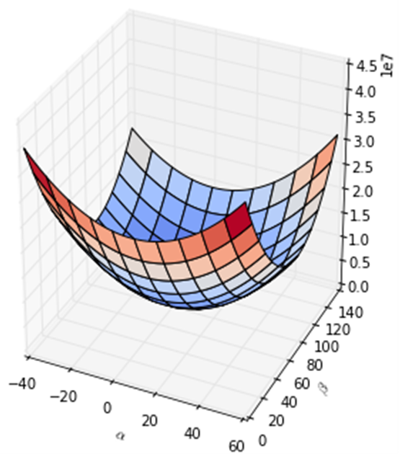
Stochastic Gradient Descent
Let's take the simplest of simple regression models for predicting y: y=α+βx.
How do we know whether one model fits better than another? We calculate the error or cost of the predictions. For regression models, the most common cost function is mean squared error:
Cost = J(α,β)=1/2n∑(y^−y)power(2)=1/n∑(α+βx−y)power(2)

Slide 22
Regression Trees
Decision trees where the target variable can take continuous values are called
regression trees.
Same structure as decision tree
Predict = average target value
Gain = reduction in standard deviation

Slide 23
Clustering
Given a set of unlabeled instances, distribute them into homogeneous groups according to
some common relations or affinities.

Slide 24
Micro-Clusters
What is a Micro-Cluster
A Micro-Cluster is a set of individual data points that are close to each other and will be treated as a single unit in further offline Macro-clustering.
View of Micro-Cluster
View of Macro-Cluster

Slide 25
Micro Cluster Creation
It is assumed that a total of q micro-clusters are maintained at any moment by the algorithm.
This is done using an offline process (k-means) at the very beginning of the data stream computation process.

Slide 26
Example
C_ID: [C1, C2, C3]
C_ID: [C1]
C_ID: [C2, C3]
Time: T
Time: T-h
Result: T-h

Slide 27
CluStream/DenStream/DBSCAN
CluStream
Linear sum and square sum of timestamps
Delete old microclusters/merging microclusters if their timestamps are close to each other
DenStream
Microclusters are associated with weights based on recency
Outliers detected by creating separate microcluster
DBSCAN:
Density-based Clustering locates regions of high density that are separated from one another by regions of low density.

Slide 28
An Example
MinPts = 4
ε
C₁
C₁
ε
ε
C₁

Slide 29
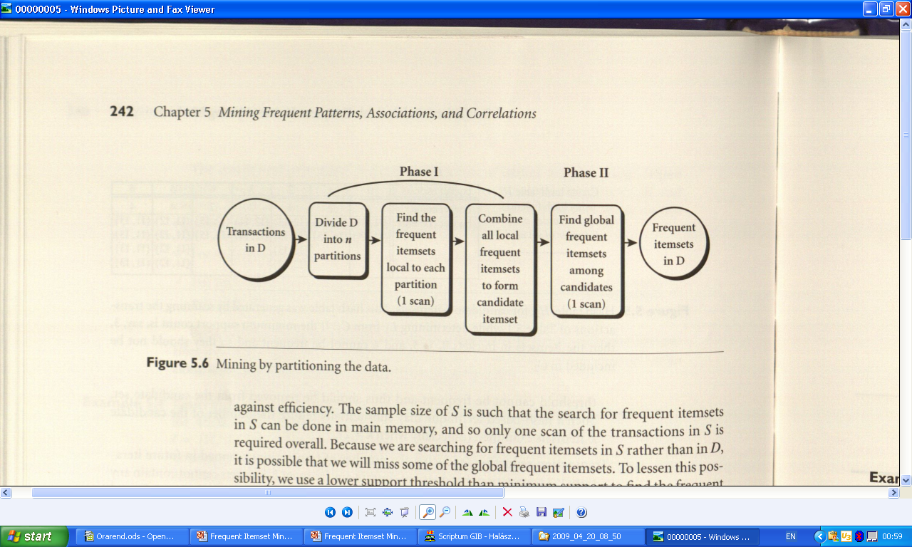
Frequent Item-set Mining Improving the efficiency of Apriori

Slide 30
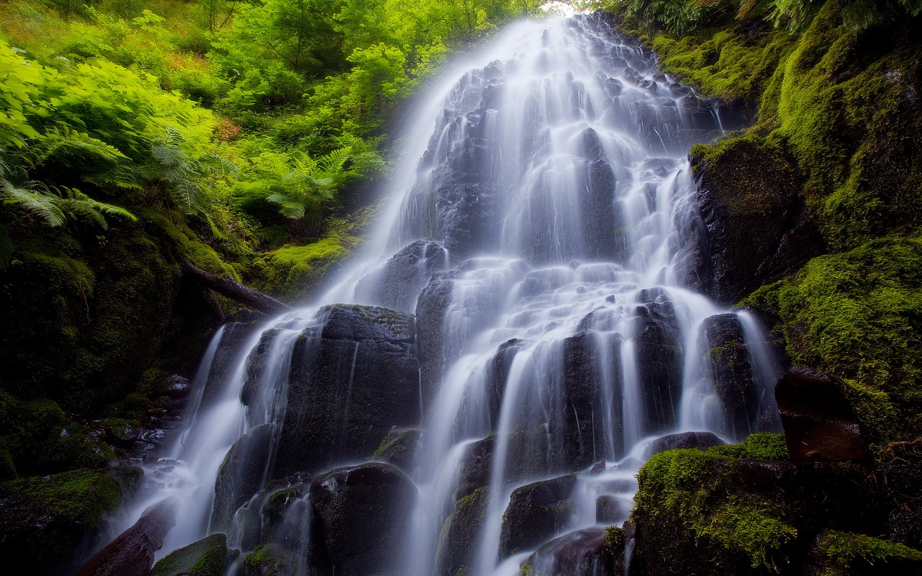
Distributed Stream – Survival of the fittest

Slide 31
Classification - Hadoop AllReduce
MPI AllReduce on MapReduce
Parallel SGD + L-BFGS
Aggregate + Redistribute
Each node computes partial gradient
Aggregate (sum) complete gradient
Each node gets updated model

Slide 32
Classification - Parallel Decision Trees
Quickly construct histograms at the processors, which compress the data to a fixed amount of memory, discover, and show, the underlying frequency distribution (shape) of a set of continuous data.
A master processor uses this information to find near-optimal split points to terminal tree nodes.
Guarantees on the local accuracy of split points imply guarantees on the overall tree accuracy.
• Which kind of parallelism?
• Task
• Data
• Horizontal
• Vertical

Slide 33
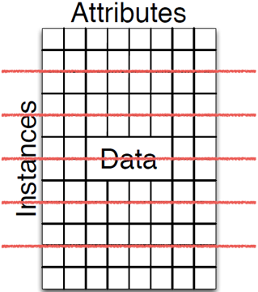
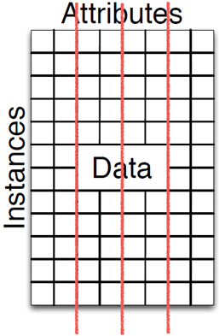
Classification - Parallel Decision Trees
Horizontal Partitioning
Vertical Partitioning

Slide 34
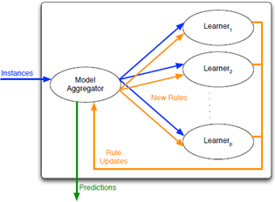
Regression - VAMR
Vertical AMRules
Model: rule body + head
• Target mean updated continuously
with covered instances for predictions
• Default rule (creates new rules)
Learner: statistics
• Vertical: Learner tracks statistics of
independent subset of rules
• One rule tracked by only one Learner
• Model -> Learner: key grouping on rule ID

Slide 35
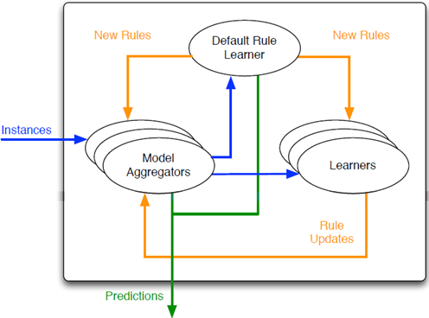
Regression - HAMR
VAMR single model is bottleneck
Hybrid AMRules
(Vertical + Horizontal)
• Shuffle among multiple
Models for parallelism
Problem: distributed default rule
decreases performance
• Separate dedicate Learner
for default rule

Slide 36
Link to presentation and code on github
Github Repository Link: https://github.com/sgupta13/bigdata

Slide 37
Questions?

